Slide 1
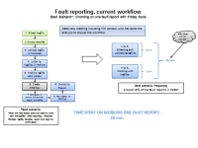
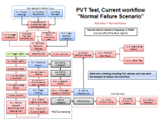
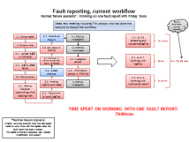


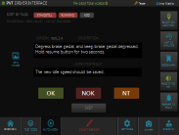
 | Title | Ref: (i.e.3C ID No. QJ no, Protus…) | Date | Owner (name, department, phone) | Accountable & Coach
 | Tool for CV Testing has become out-of-date – Log files, test cases and test execution mgmt |  | 2016-03-02 | Jessica Erlandsson, BF59080, +46-31-3221513
BACKGROUND PDCA
Current tool, eFACTS, a set of applications are used in Complete Vehicle testing – PVT, RT, AET, Field Testing, Safety, VCE testing, Bus testing - has become out of date. The tool is used for log files connected to PROTUS reports, test cases and test execution management. The tool was designed and created from a blank paper without requirements (could not be assigned to any supplier, not even Volvo IT) Work started after FDCG had passed in P2540 = a lot of pressure to deliver fast Original intention: to be used at one site with a small number of users working with few vehicles from one brand
CURRENT SITUATION PDCA
Current eFACTS status: 6 sites, 76 users, 19 product classes incl buses and VCE, >200 000 logfiles have been taken, approx 20% have been linked to >27600 Protus reports Applications are not reliable anymore and stops to work quite frequently, users have started to work outside tool Continuous improvements and new ways of working not supported Inefficient work flow. Investigation shows possibilities to save 85% work load for a test engineer
PURPOSE and TARGET PDCA
Cut lead time waste with up to 85% for working with log files connected to PROTUS reports, from 96 to 14 minutes per PROTUS report on average. Improved way of working with test execution (incl Test Case mgmt) PVT: expected improved delivery 300% RT/AET: expected improved delivery 500% Traceability (needed for ISO26262)
ROOT CAUSE ANALYSIS PDCA
Heavy increase of users, complexity and number of logfiles compared to initial expectations New functionality have been frequently added The current tools can be used as a good reference, new foundation is critical
EVALUATION of COUNTERMEASURES PDCA
ACTION PLAN PDCA
FOLLOW UP PDCA
STANDARDIZE PDCA

